Slide 2


Notes:
Zowe is owned and managed by the linux foundation, as part of the open mainframe project
<Click>

Slide 3
Open
Simple
Familiar
Notes:
Its goal is to provide a platform for access to the mainframe using tools that are
<click to animate text>
Open
Simple
Familiar
<click to introduce red border around zowe.org graphic>
Information about Zowe can be found at zowe.org

Slide 4
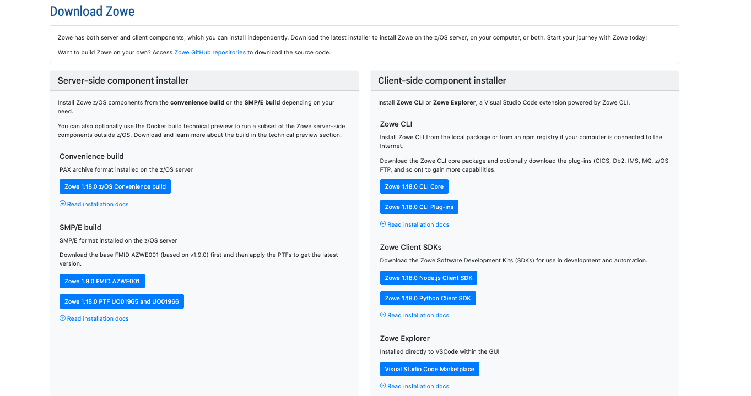
Notes:
Including links to downloads

Slide 5

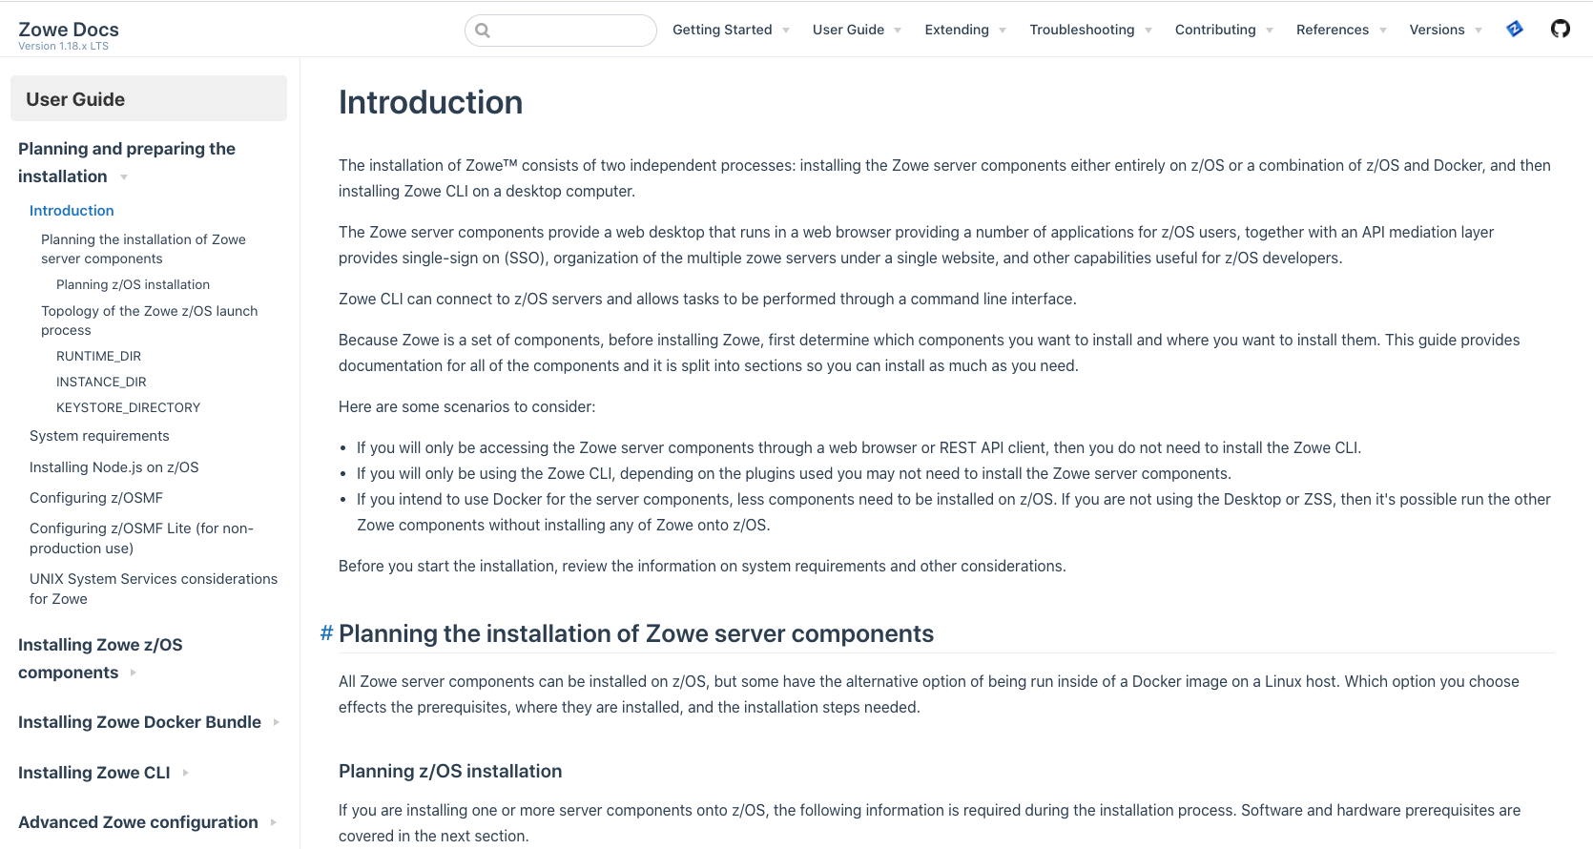
Notes:
documentation

Slide 6

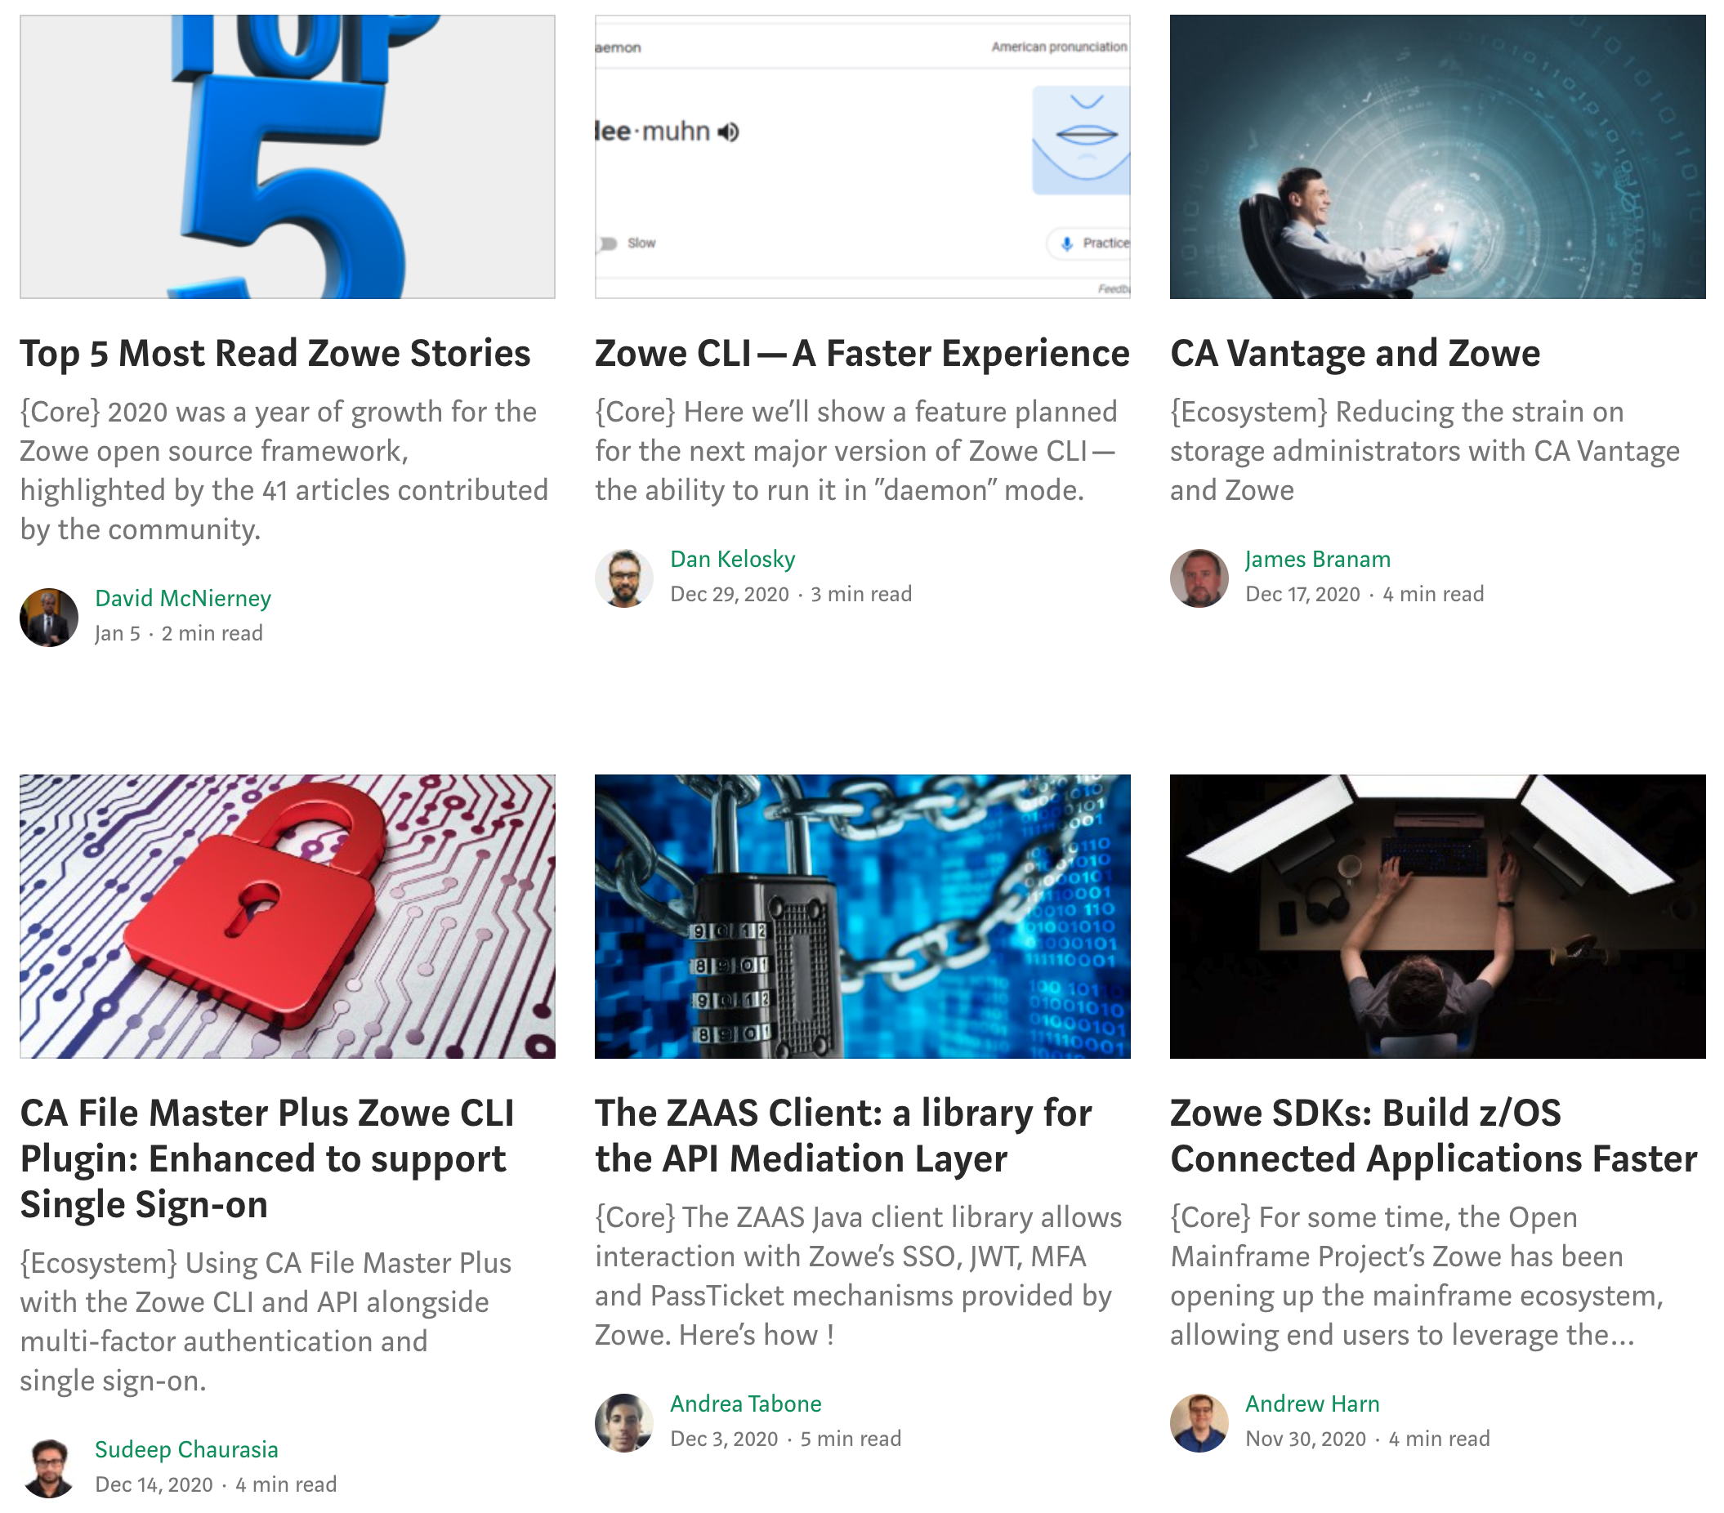
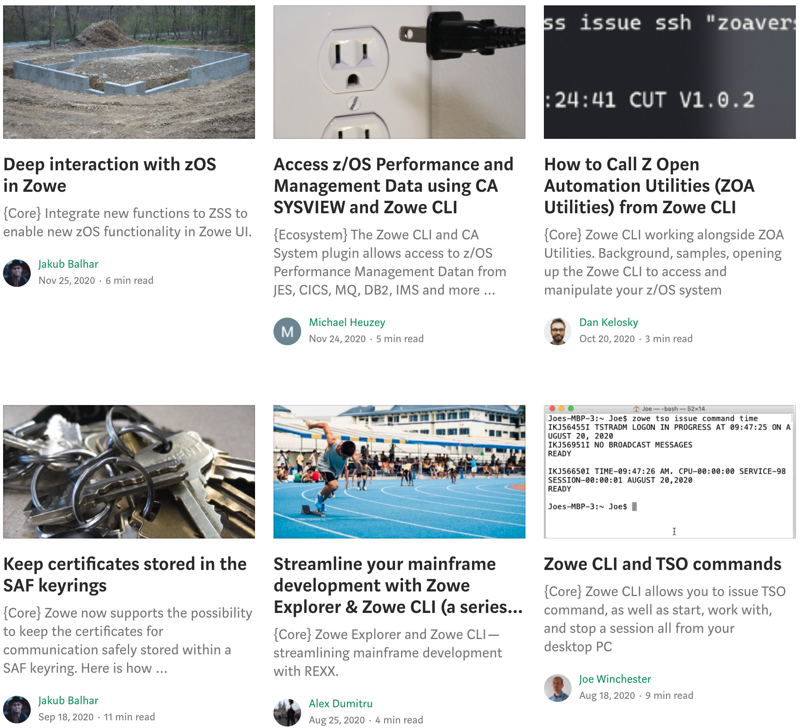
Notes:
And technical blogs

Slide 7

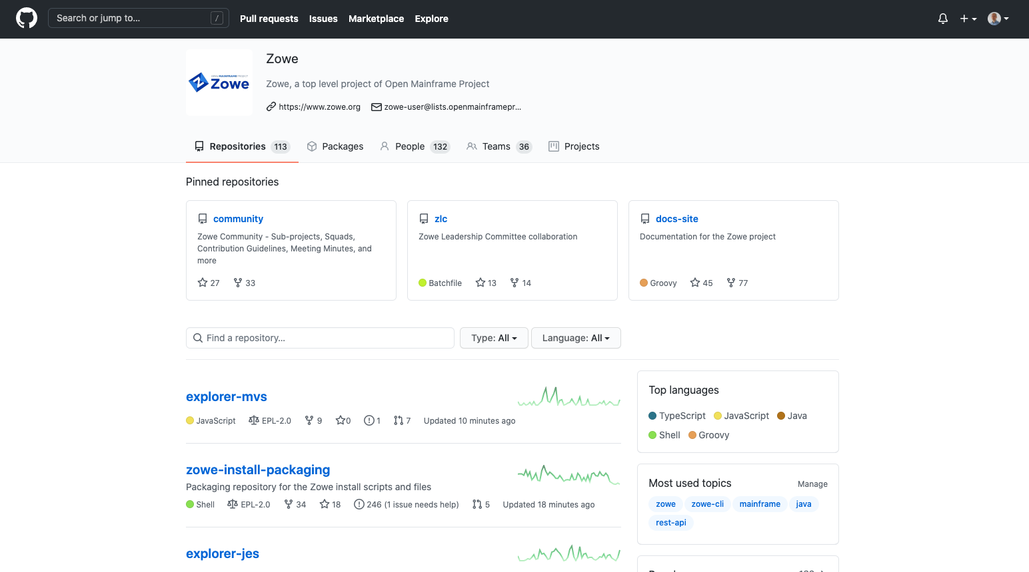
Notes:
As well as the github repositories where Zowe’s open source code is developed by its community of committers and squad members

Slide 8
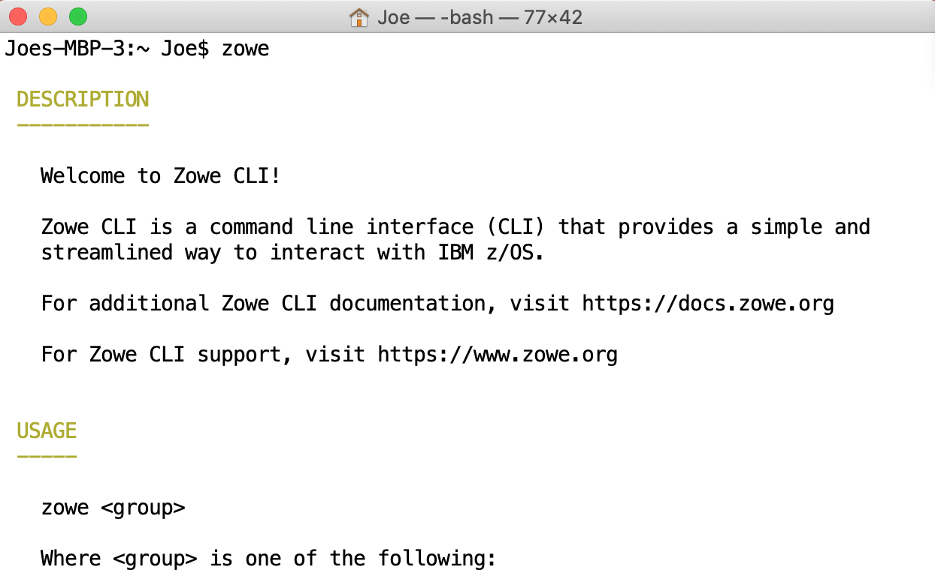
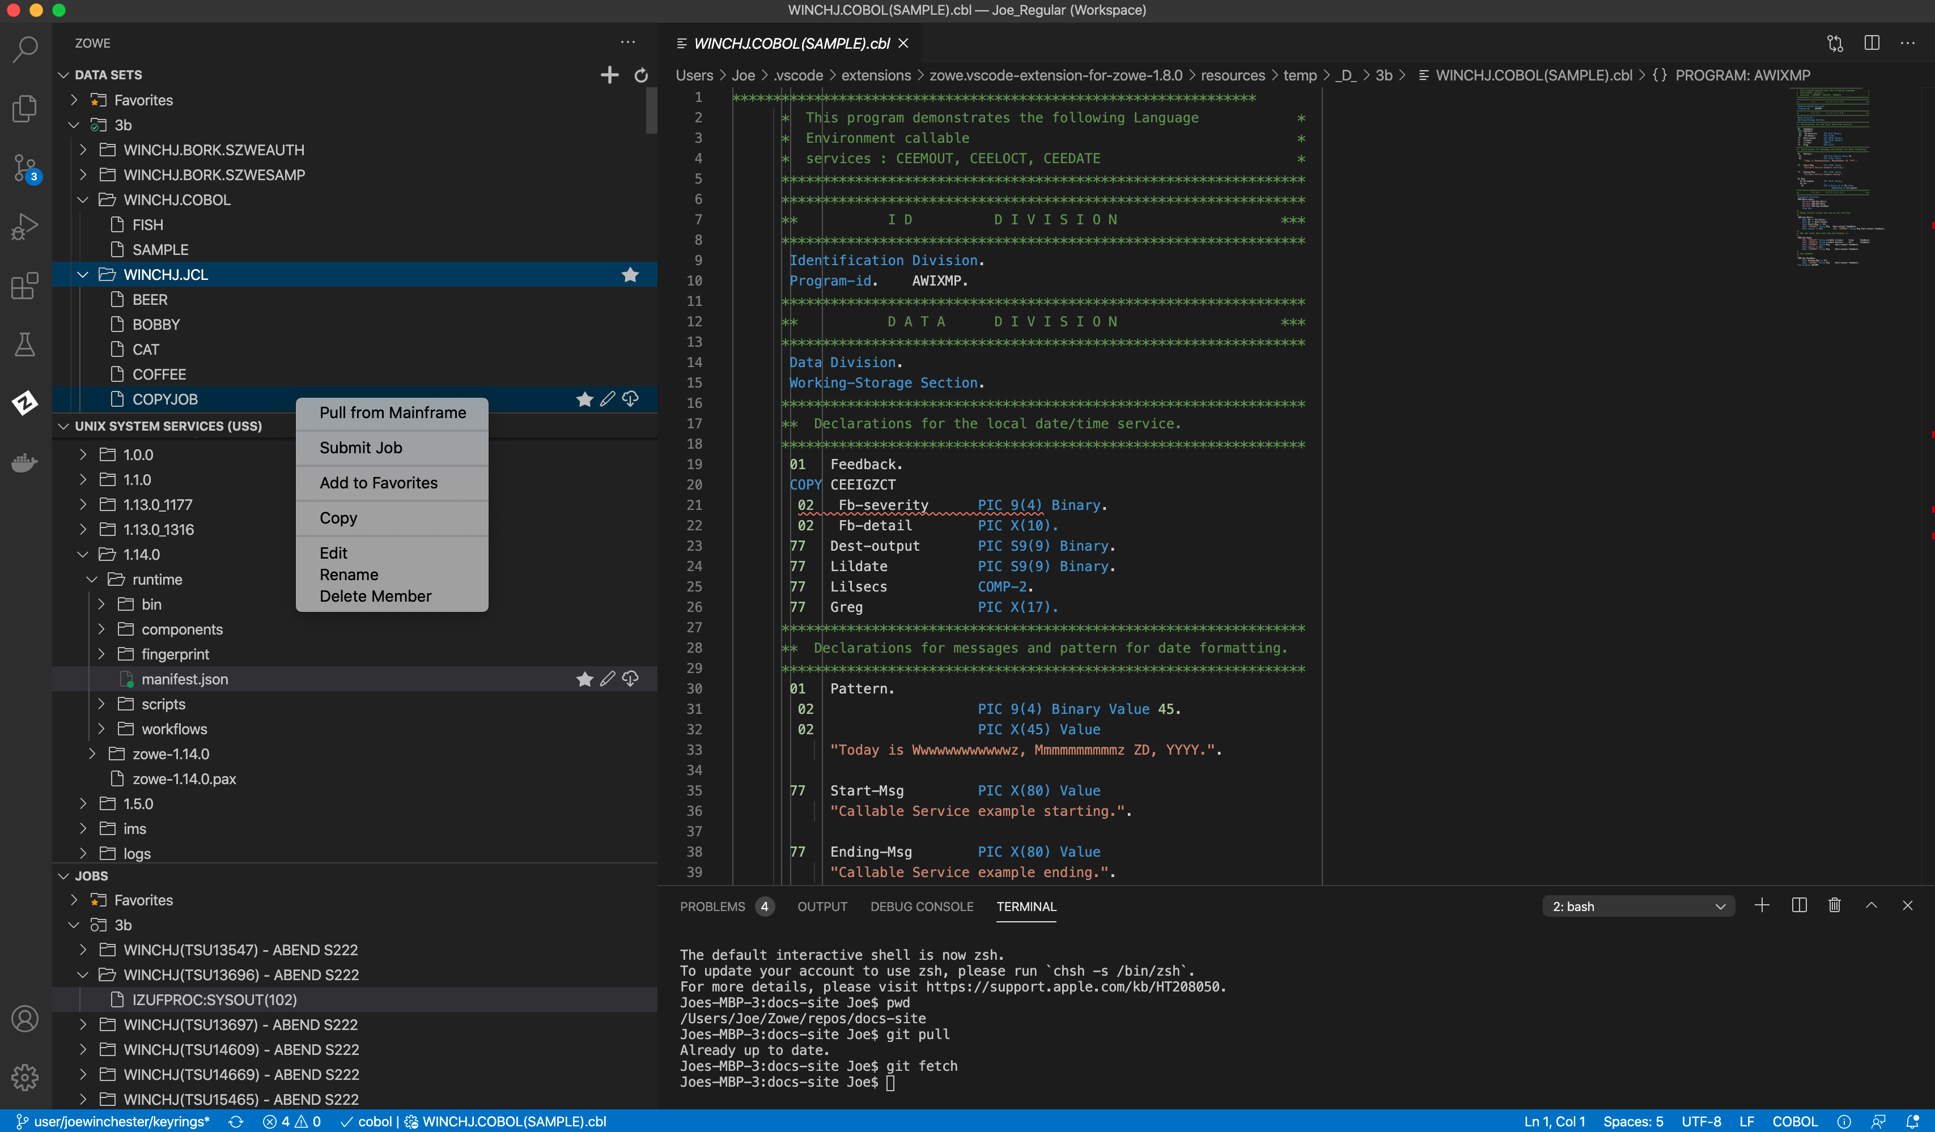
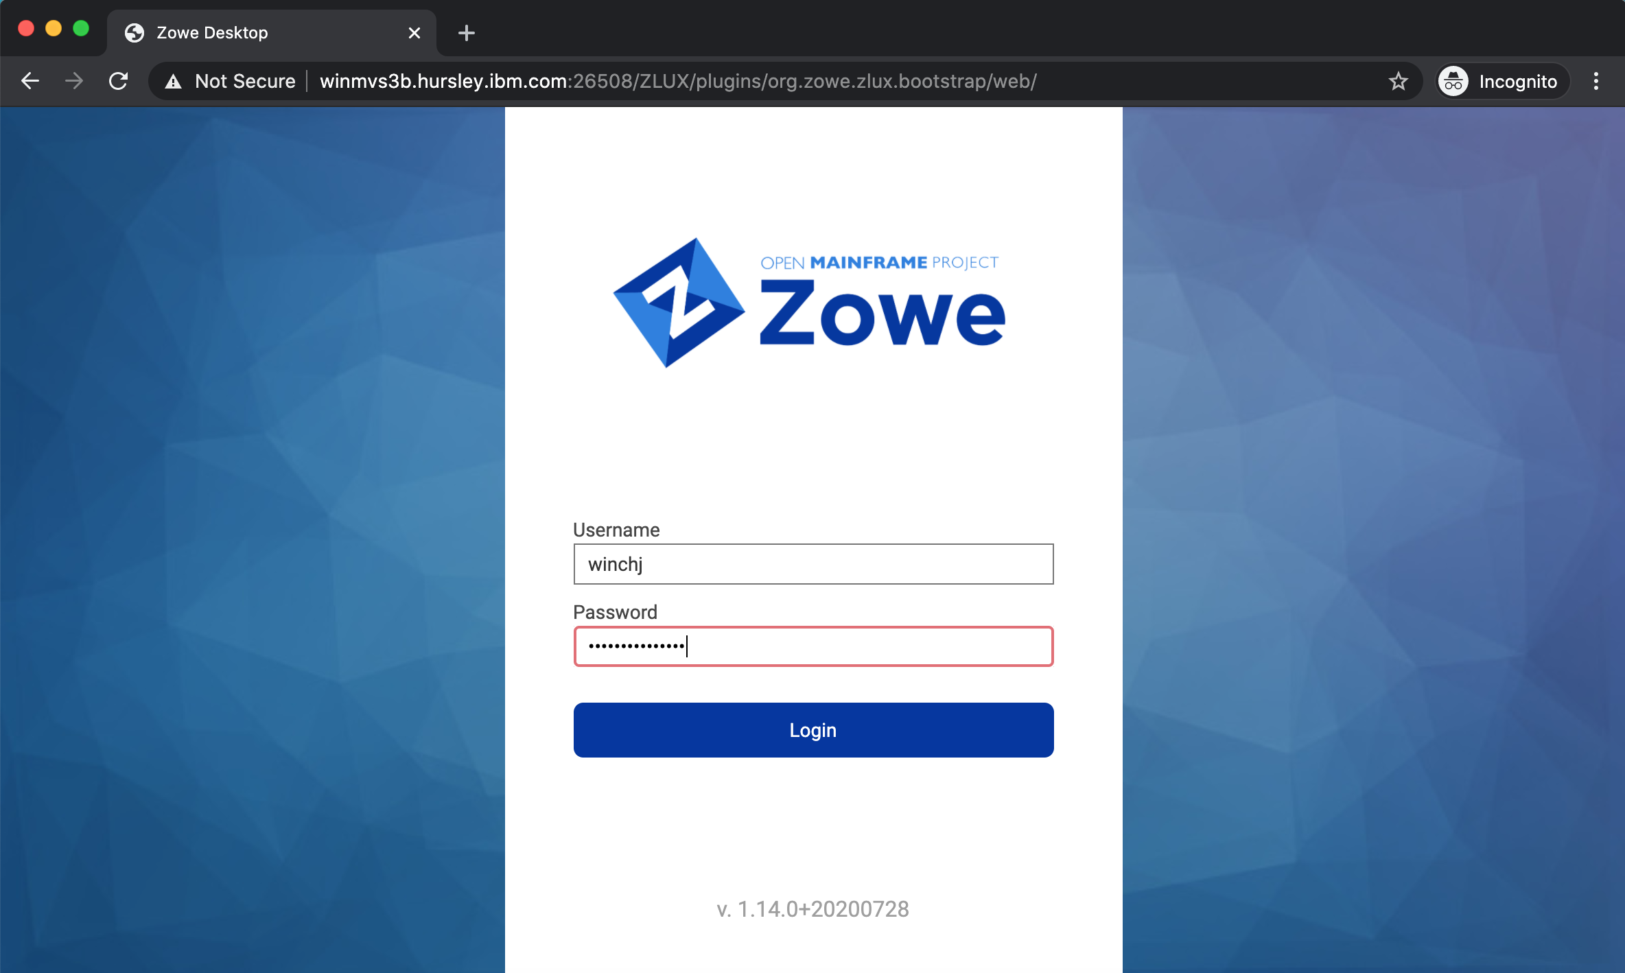
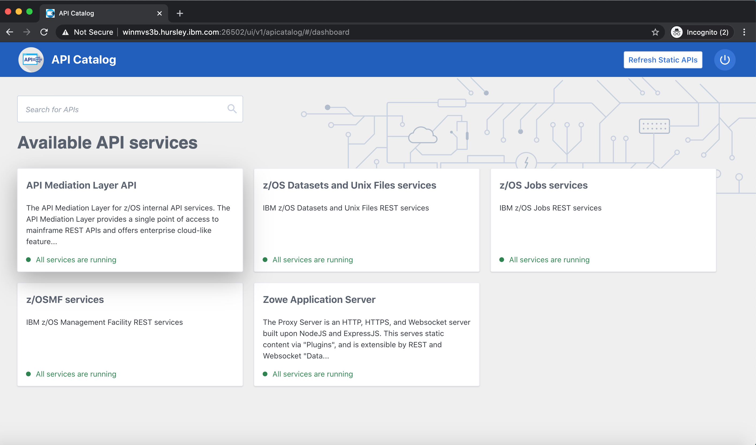
Notes:
Zowe is composed of four main components
<click>
A command line interface
<click>
A visual studio code extension known as the Zowe Explorer
<click>
A web user interface accessible through a desktop browser
<click>
And a powerful API Mediation Layer
Let’s look at each of these in more detail.

Slide 9
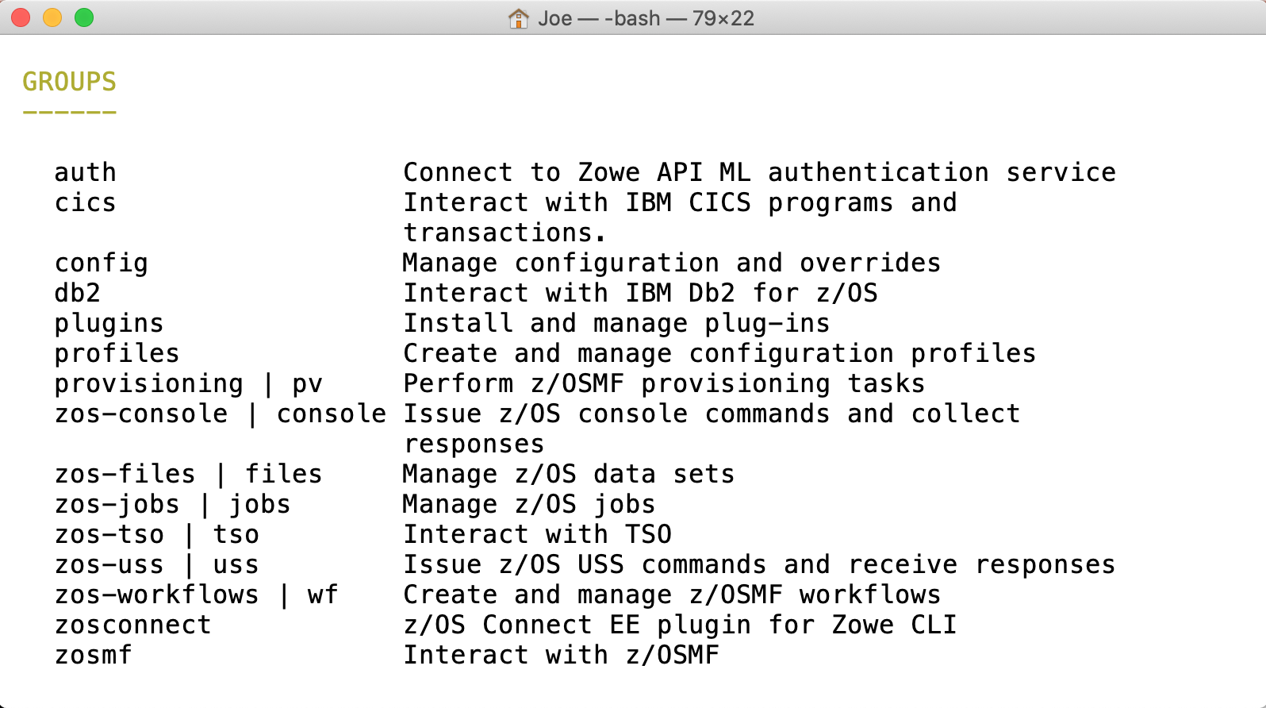
Command Line Interface
Notes:
The command user interface, or CLI, allows a user to issue commands from their PC to directly operate and manage their mainframe.
<click>
CLI commands are broken down into groups. The core set includes groups to work with
<click>

Slide 10
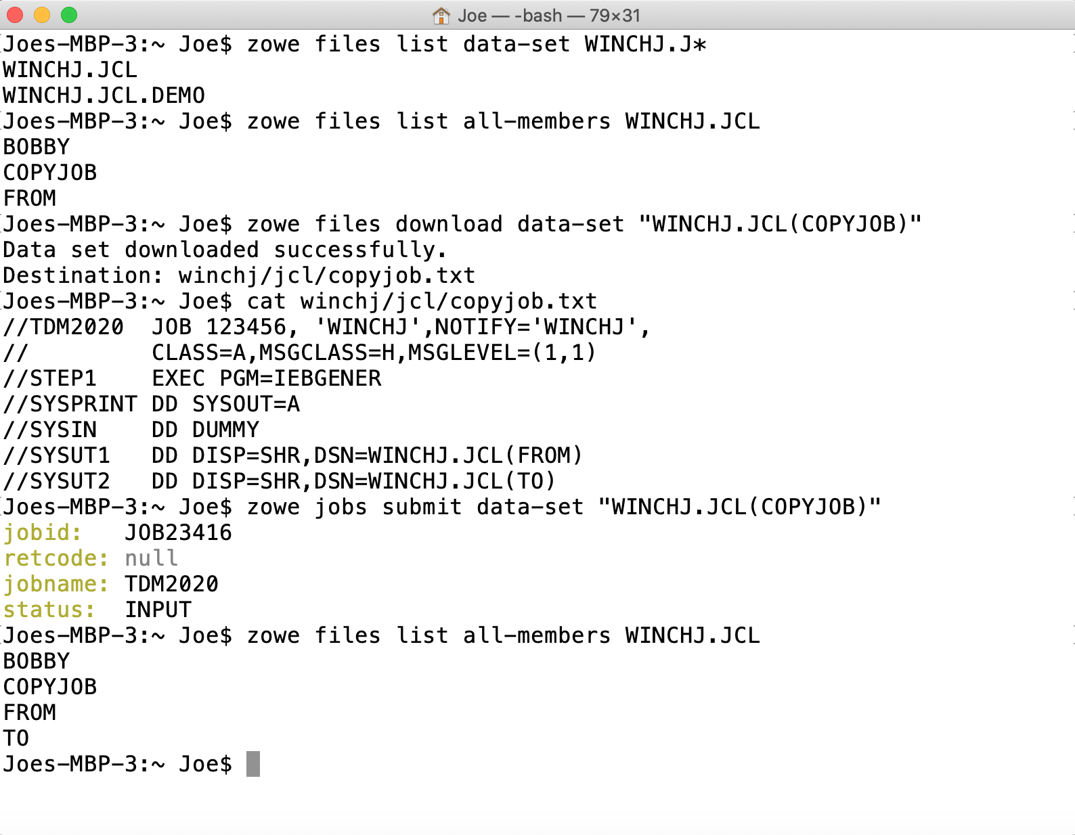
Data sets
Notes:
Data sets, where you can
<click>
list data sets for a file
<click>
List the members of a PDS
<click>
download members to your PC
<clicl>
And submit job control language data sets to the JES queue

Slide 11
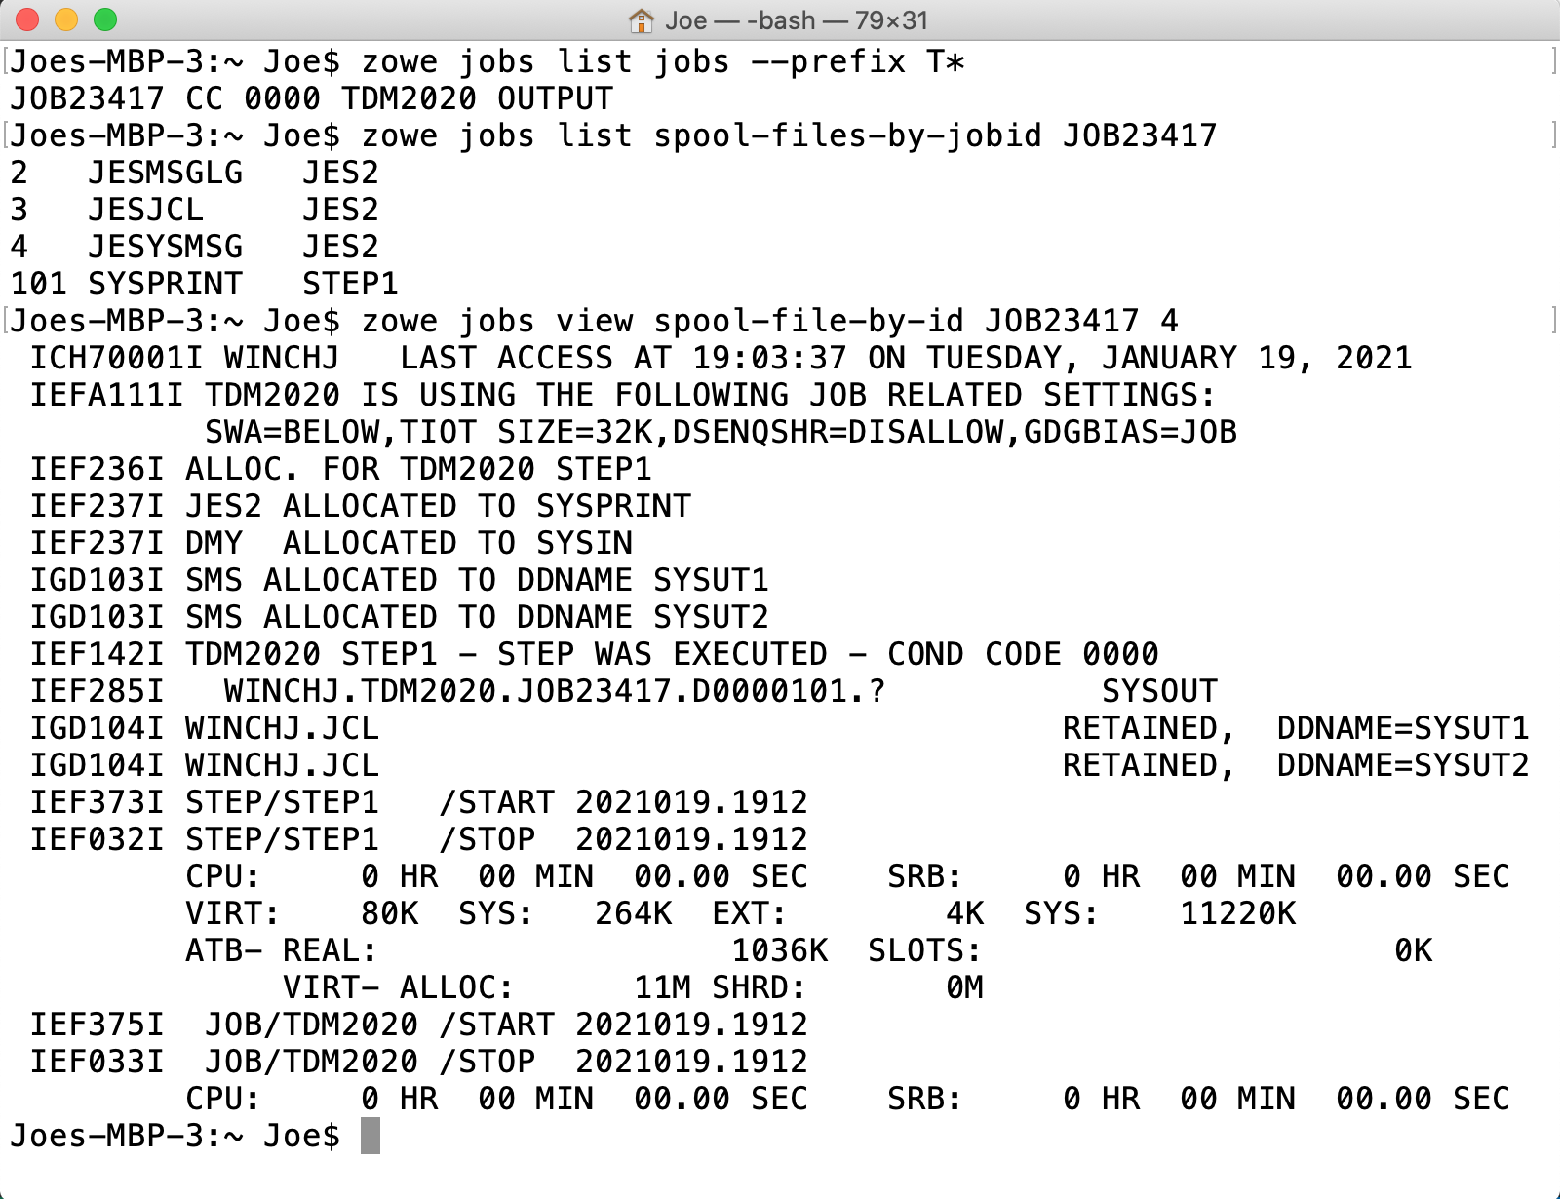
Jobs
Notes:
The jobs groups allows you to
<click>
List jobs by prefix, owner or status
<click>
View a list of spool files
<view>
As well as content for an individual spool file
<click>

Slide 12
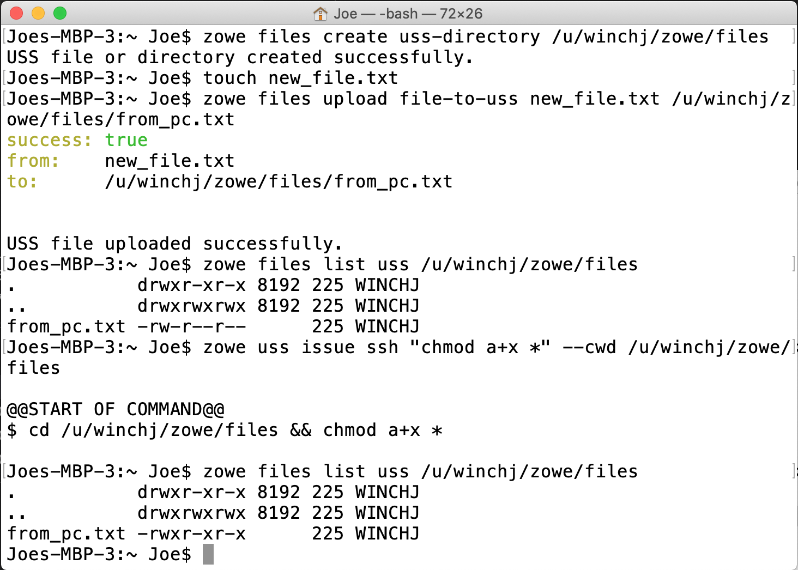
USS
Notes:
With the unix system services group you can
<click>
Create directories
<click>
Upload files from your PC
<click>
As well as issue unix commands directly within USS

Slide 13
Command Line Interface
Notes:
Other core command groups allow you to issue
<click>
TSO commands, create and manage workflows
Bec

Slide 14
DevOps
Continuous Integration Continuous Delivery Pipelines
Automation
Orchestration Scenarios
Secure Encrypted Communication
Laptop’s native credential store
Notes:
Because the CLI is running on the user’s laptop it can be embedded and executed from other tools within the same machine
Such as those for
<click>
DevOps
CICD Pipelines
Automation scripts
And other scenarios where mainframe orchestration is required
This allows a developer familiar with their existing software suite to seamlessly use the Zowe CLI to perform mainframe tasks
<click>
All of this is done with encrypted communication using the laptop’s native credential store

Slide 15
Command Line Interface
Notes:
As well as core capabilities Zowe CLI is built to be an extensible framework allowing additional plugins to be installed, such as those for CICS, DB2 and other mainframe runtimes

Slide 16

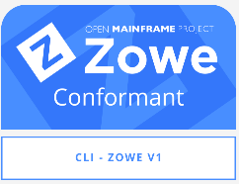
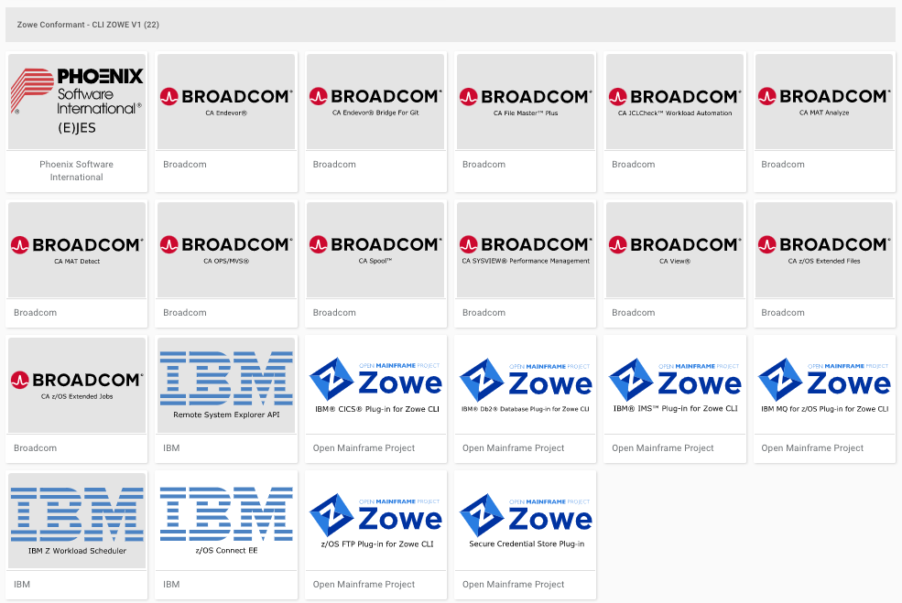
Notes:
Software vendors can built their own CLI plugins using a set of defined public APIs
<click>
The Zowe conformance program is a certification process that issues badges to extensions who have built and packaged and execute these APIs, ensuring consistency of end user experience and compatability between plugins
A number of extensions are available from vendors including
<click>
CA Endeavor, I
<click>
BM z/OS Connect
<click>
Phoenix Software EJES, and more

Slide 18

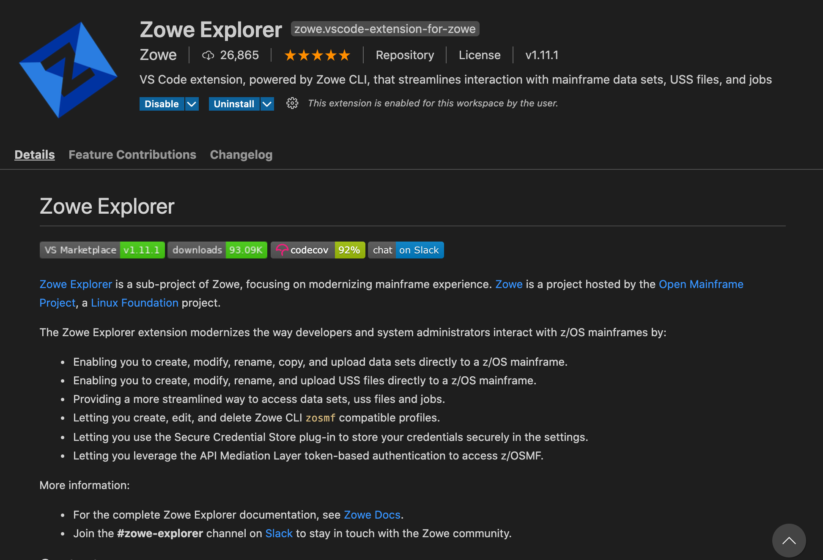
Zowe Explorer

Slide 20
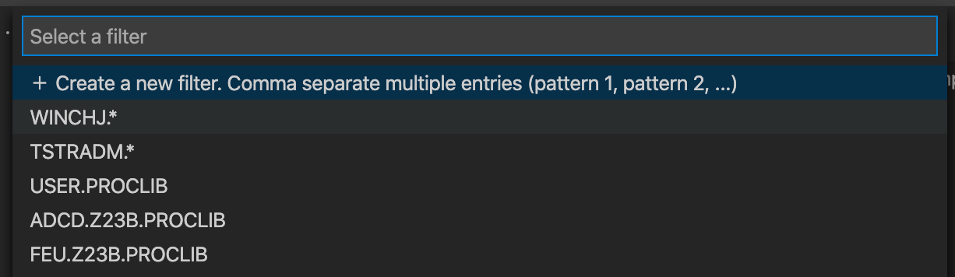
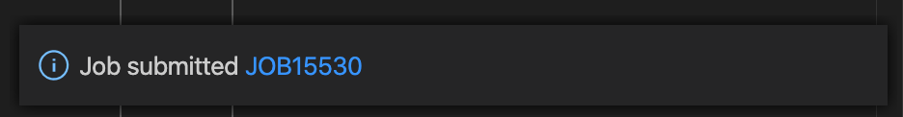
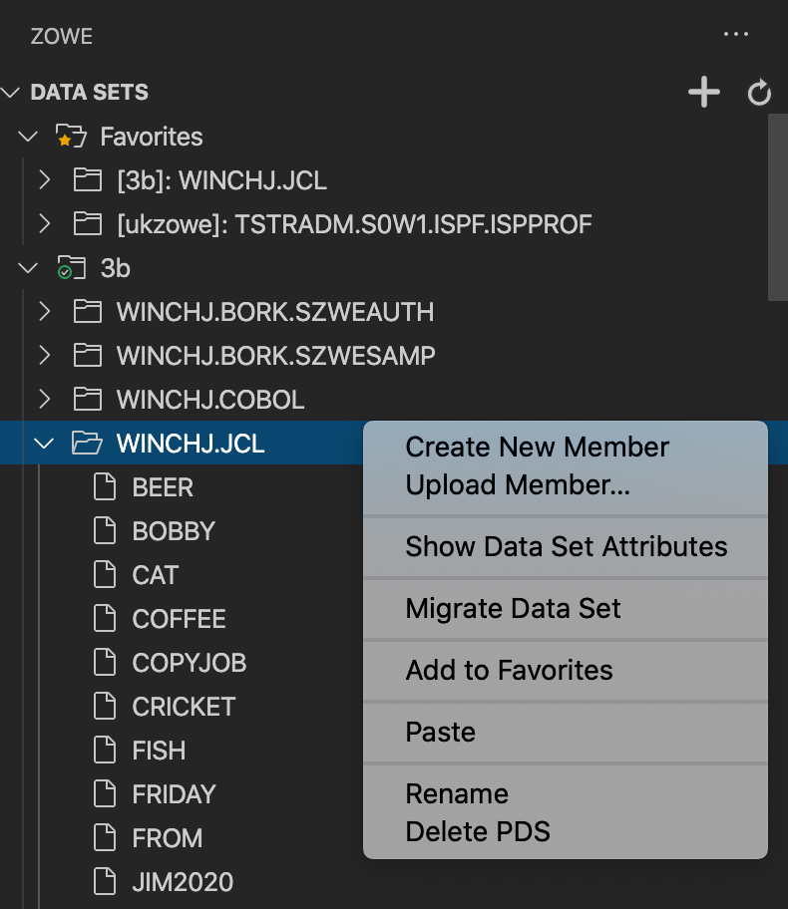
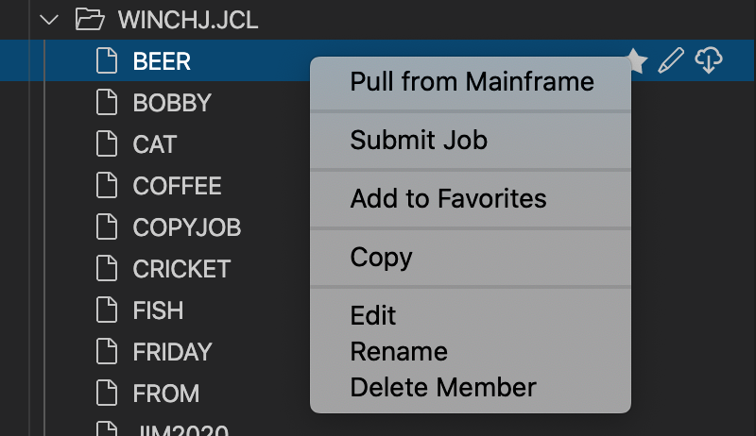

Slide 21
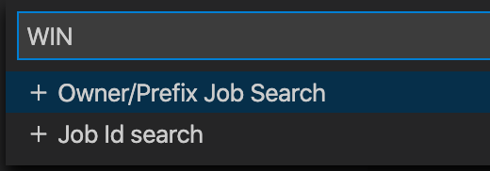
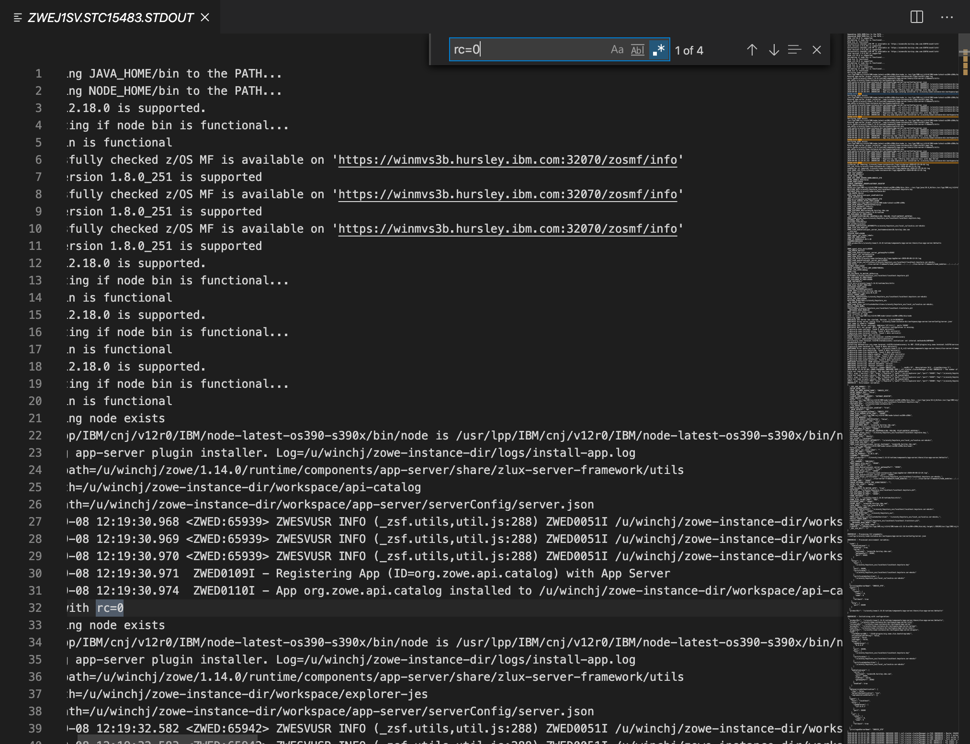
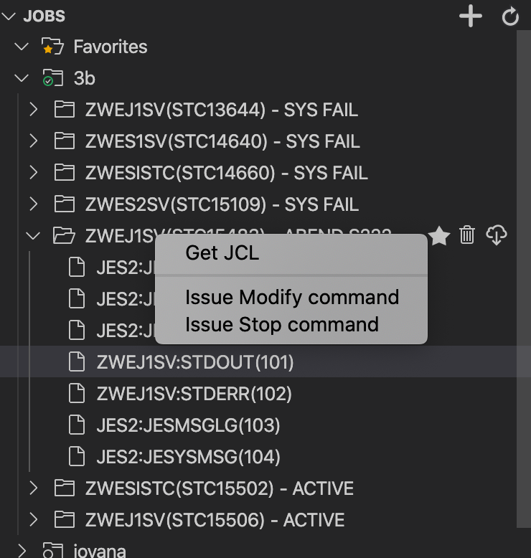

Slide 22
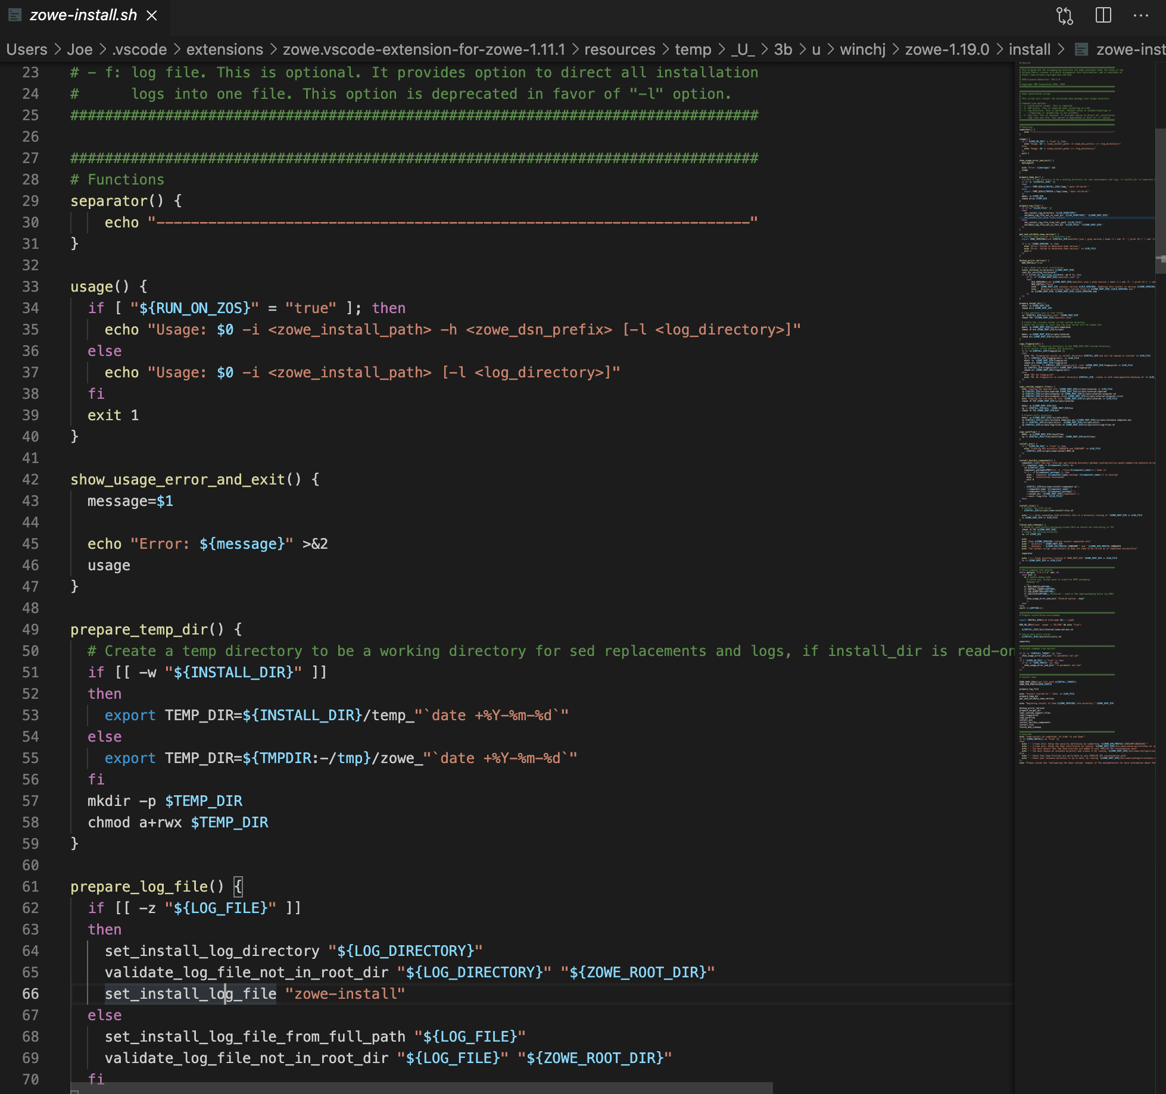
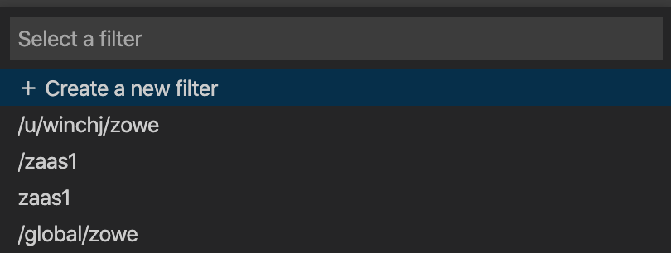
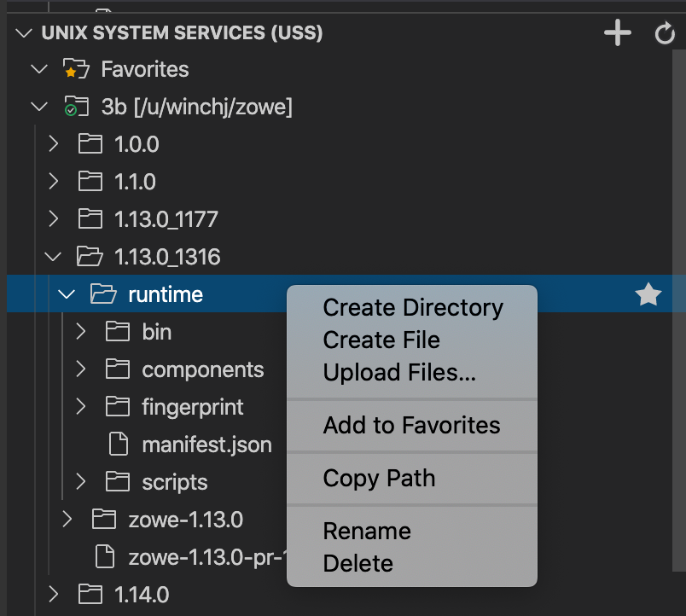

Slide 24
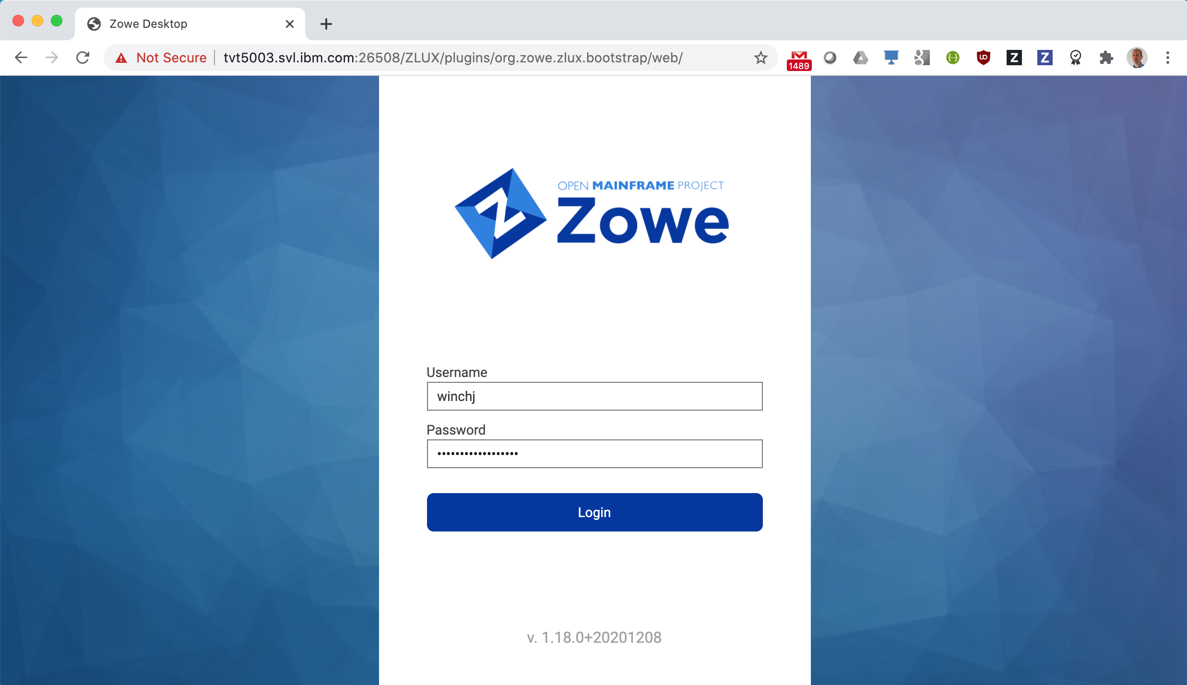
Zowe Desktop

Slide 25
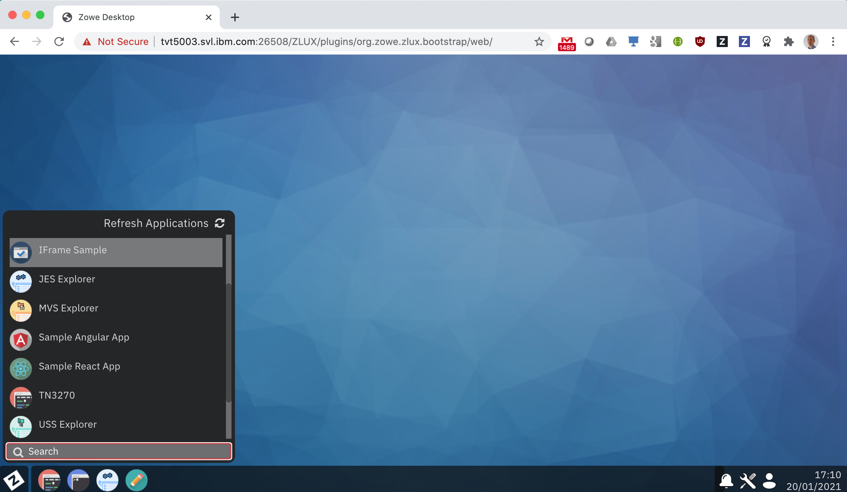

Slide 26
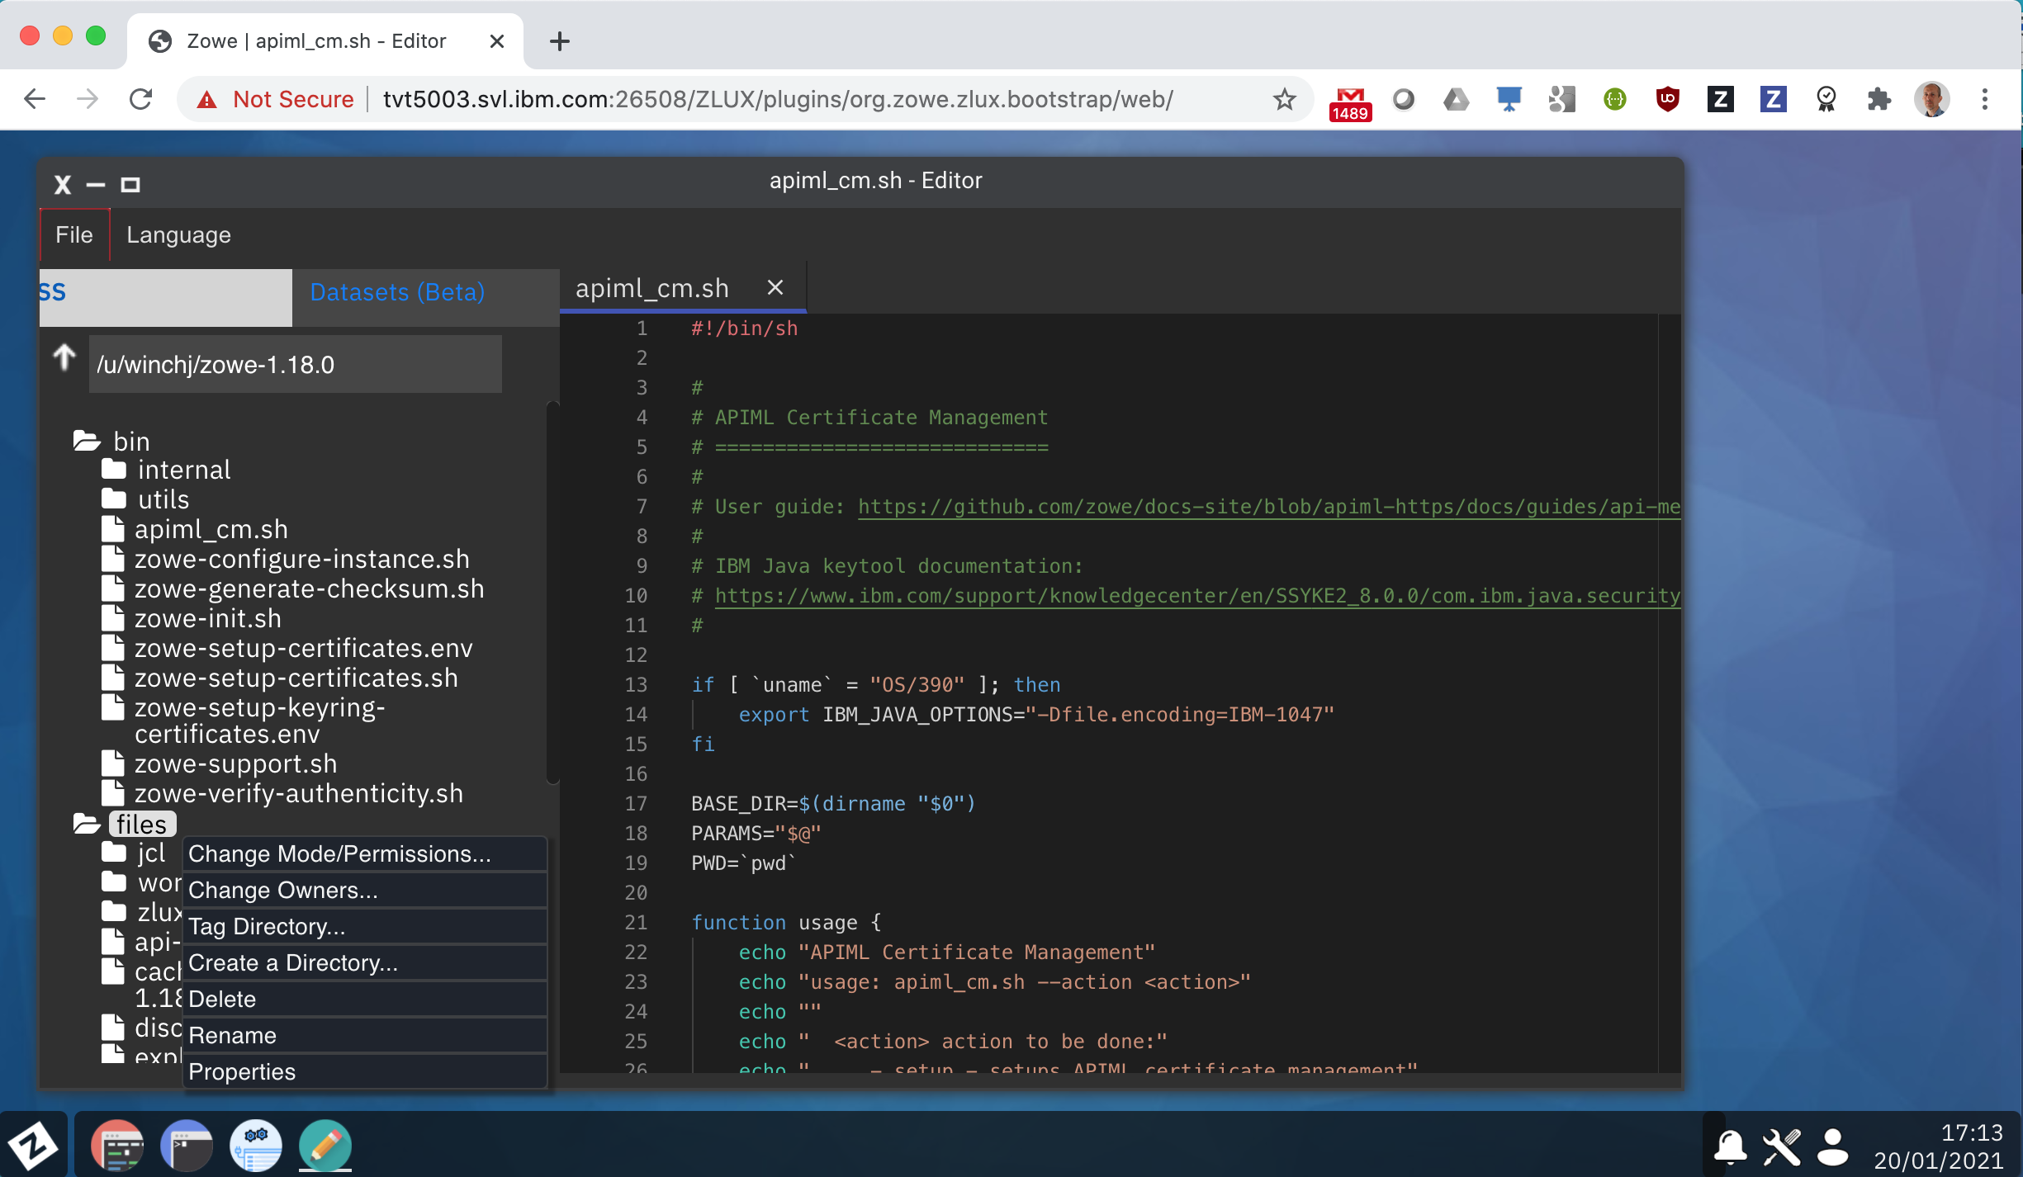

Slide 27
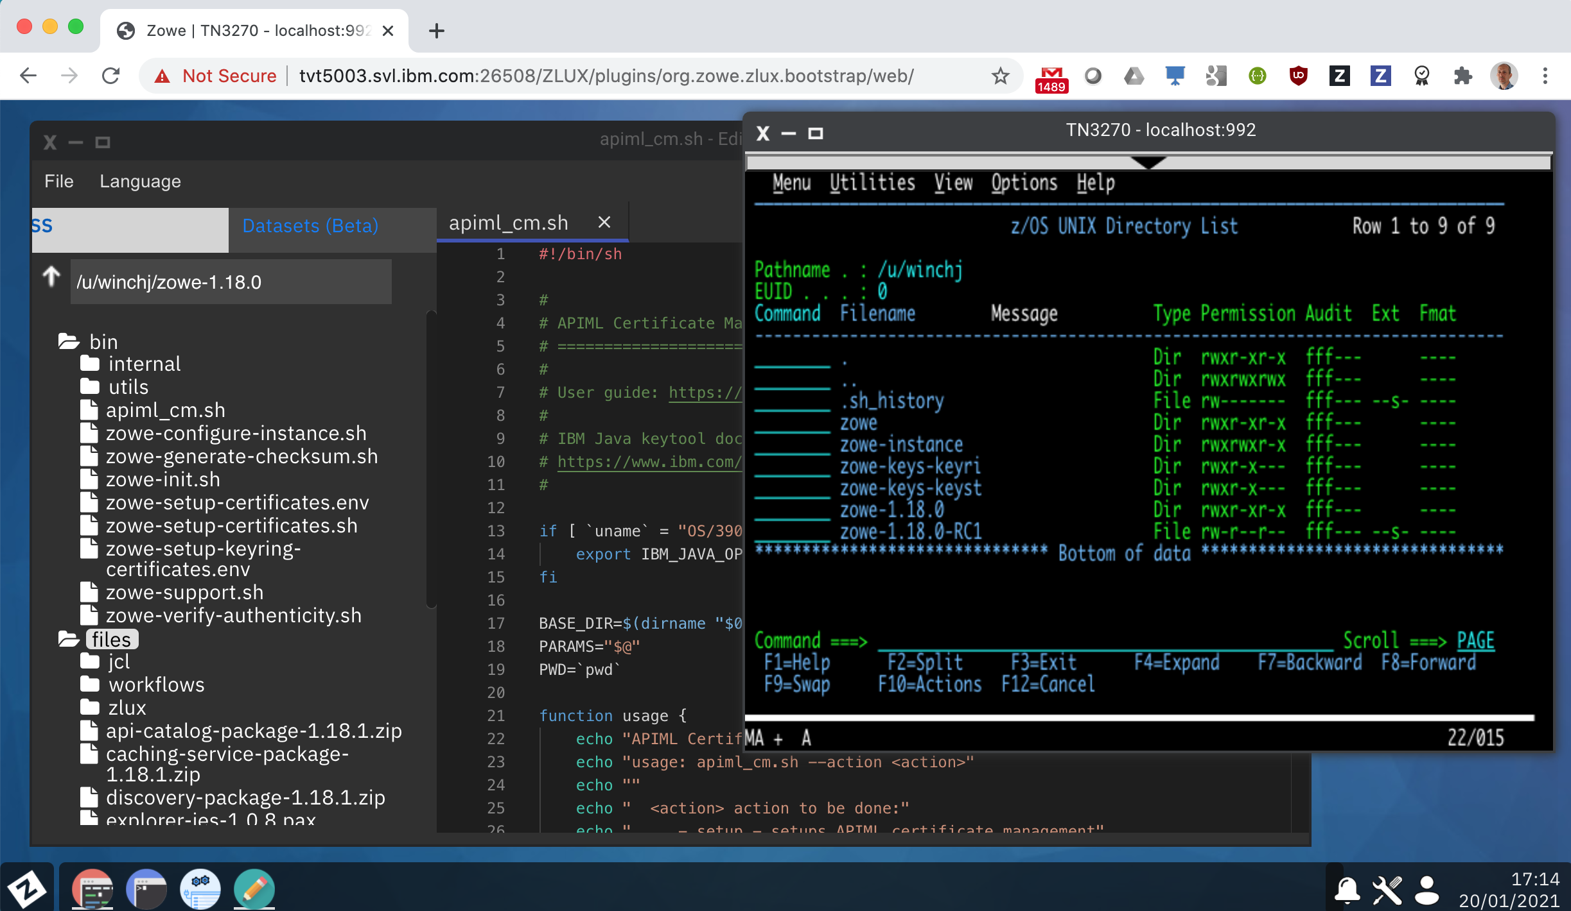

Slide 28
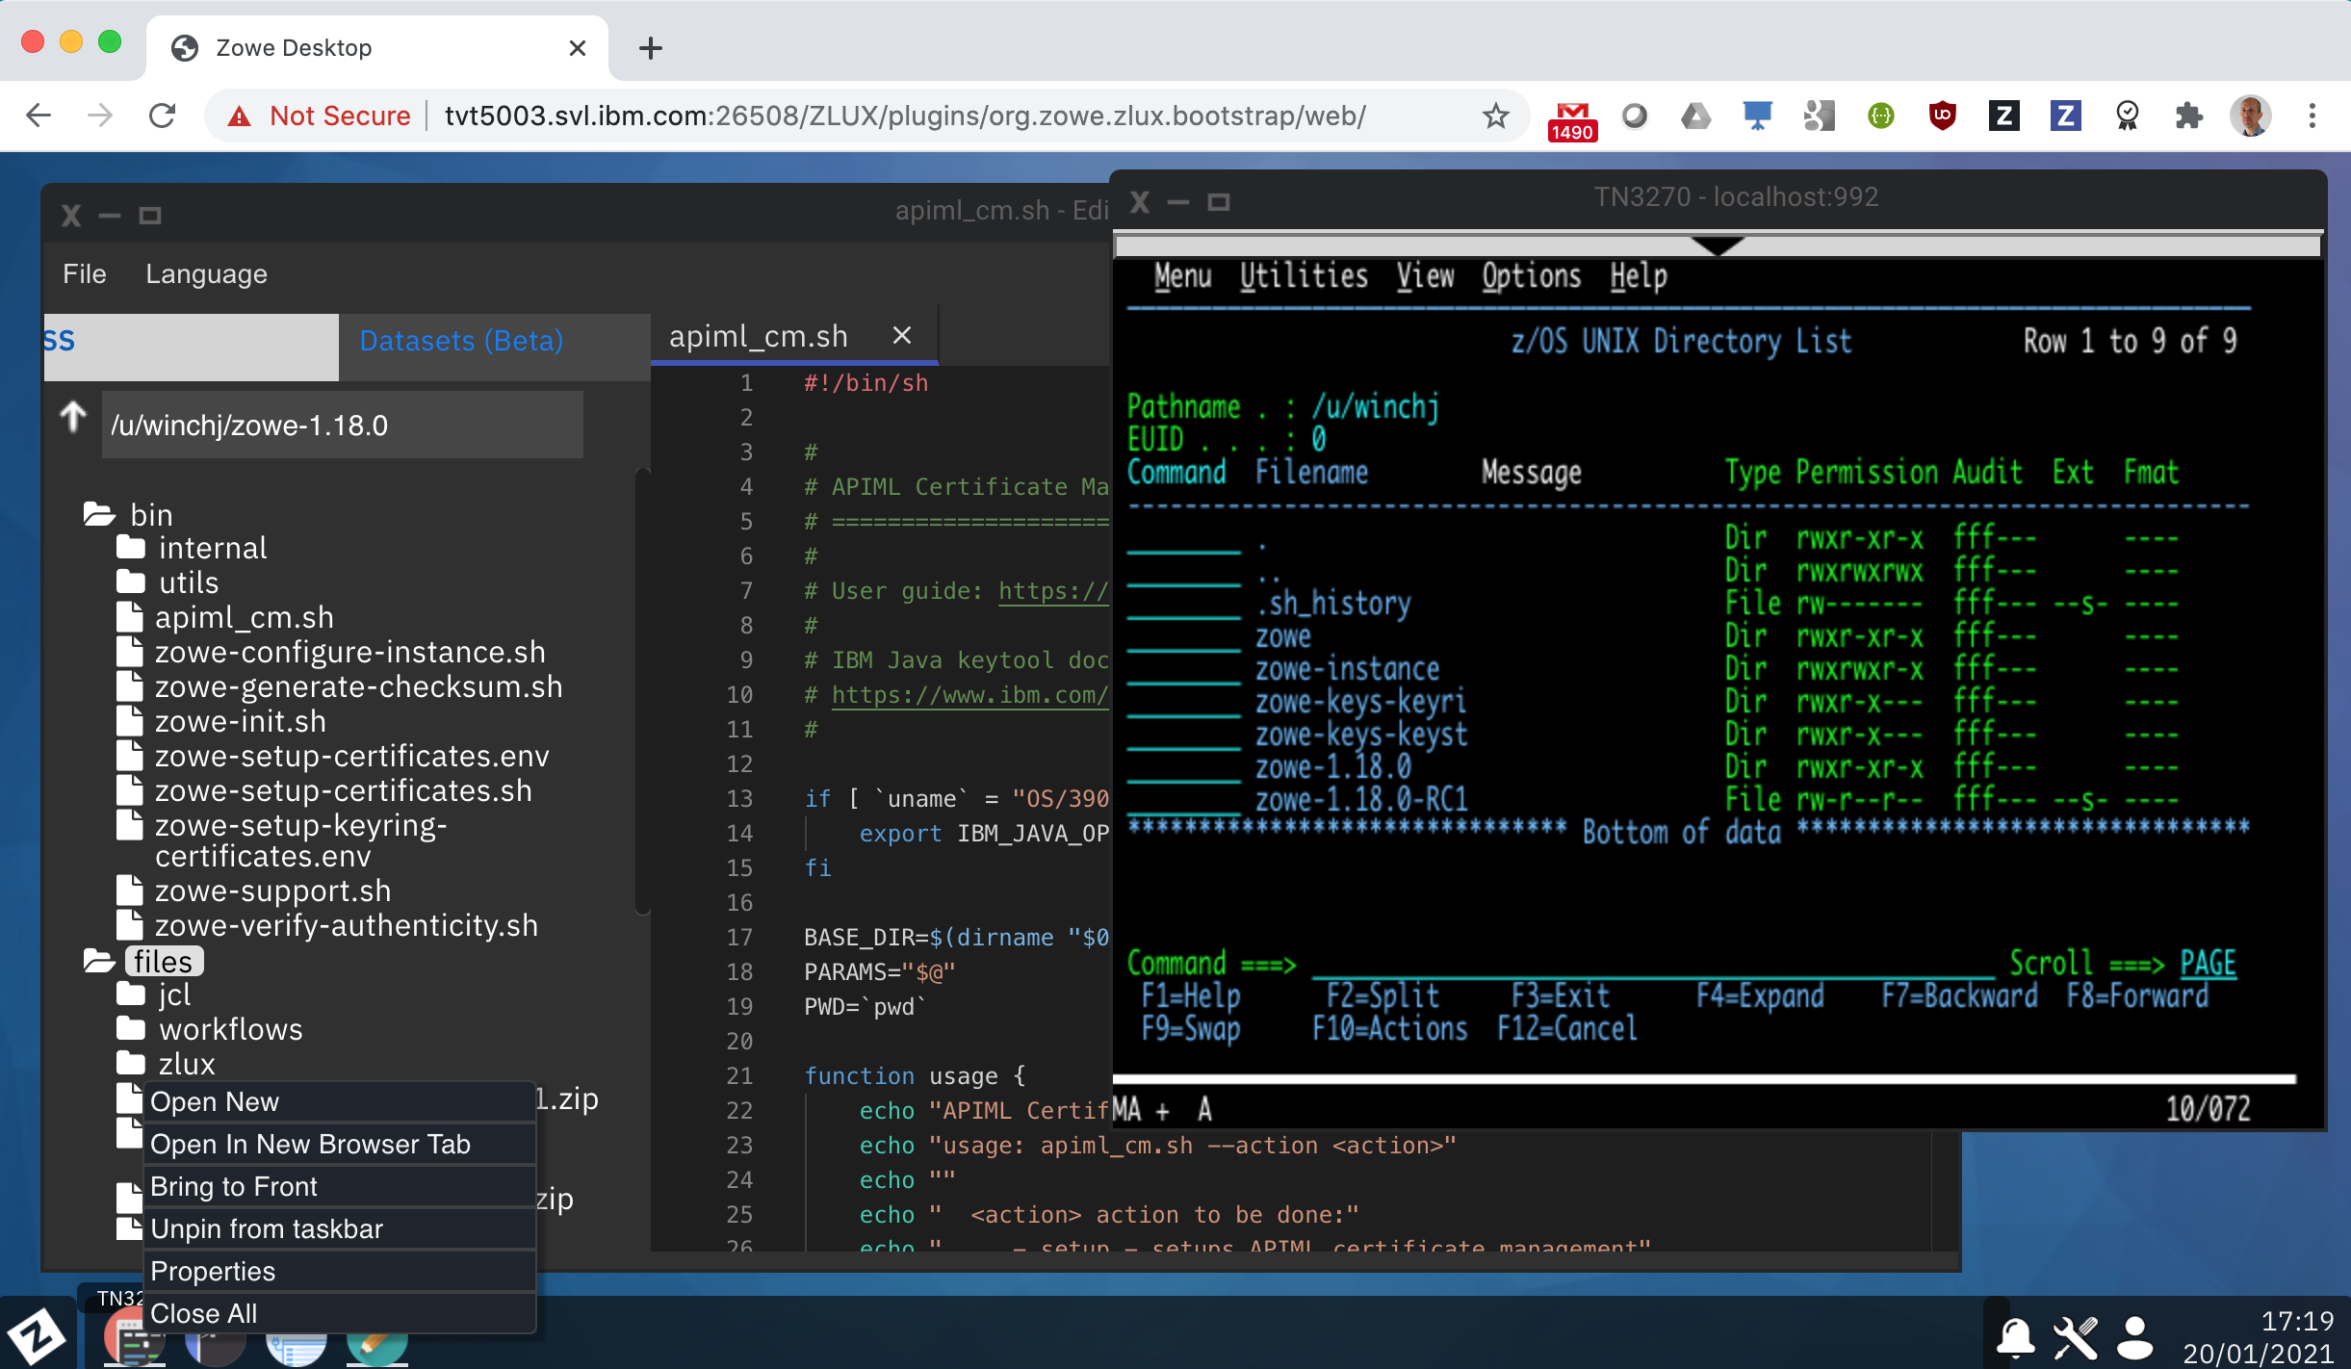

Slide 29
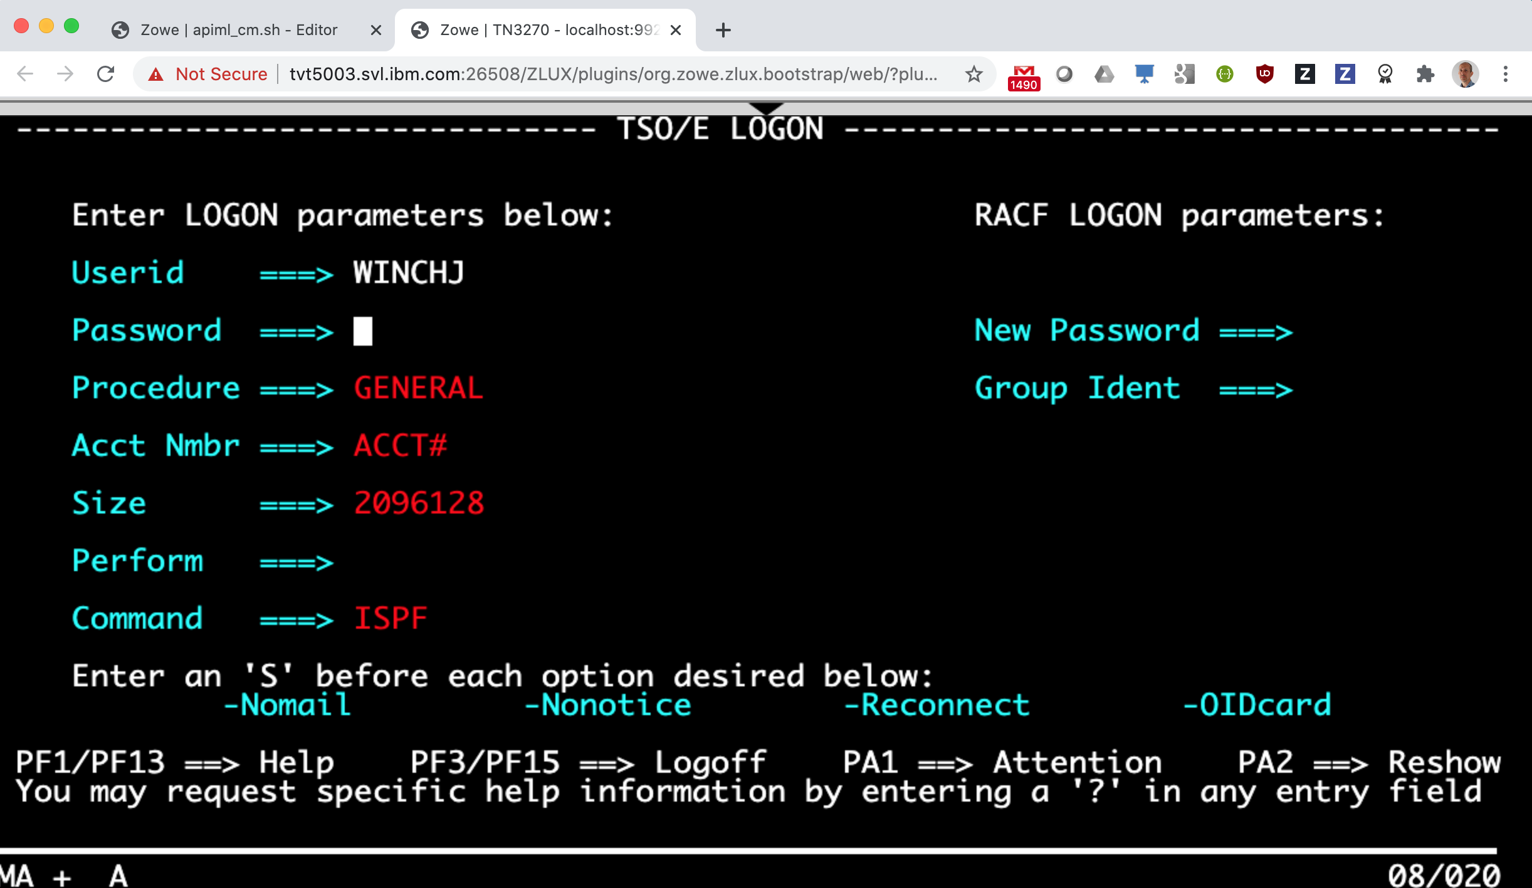

Slide 30
Modern GUIs
Traditional Interfaces
Side by side in a web browser
Single sign-on
App to app launching

Slide 32
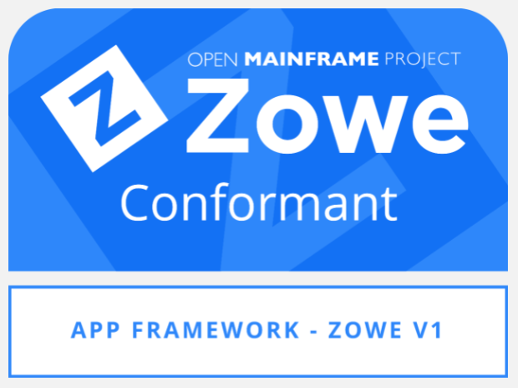

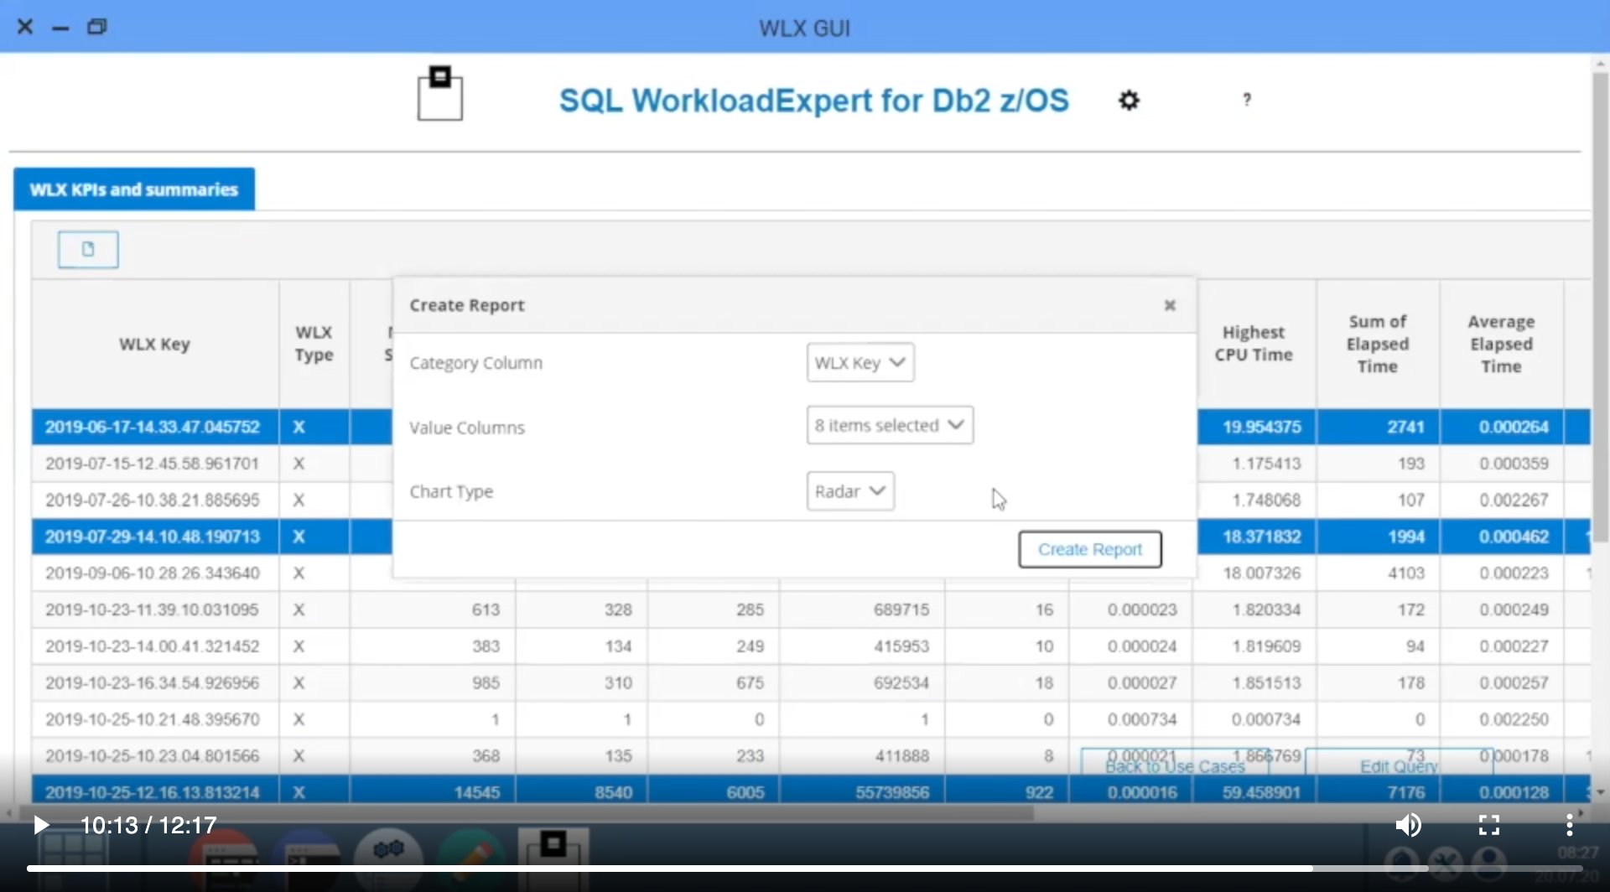
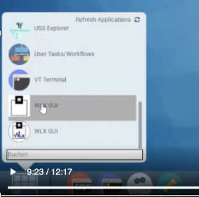

Slide 35
